Slide 1
Quarterly HR Community Meeting
Human Resources Administration
August 20, 2019

Slide 2
Quarterly HR Community Meeting
AGENDA
August 20, 2019, 10:00am – 12:00pm
Room 1816, 18th Floor, West Tower
Welcome Al Howell
Cyber Security Training David Allen, Chief Information Security Officer, GTA
Human Trafficking Prevention Training Al Howell
Launching Our 2020 Flexible Benefits Season Leneequa Morris Barbara Heard
Preventing Sexual Harassment Update Jenna Wiese, Deputy Inspector General, OIG
Al Howell
Campus Recruiting Update Monique Jenkins
Meeting Wrap-up Al Howell
Join us for an informal HR Community lunch in the cafeteria following the meeting.

Slide 3
Cyber Security Awareness Training
David Allen

Slide 4
Proofpoint Training Overview
Georgia Technology Authority
Office of Information Security
David S. Allen
Chief Information Security Officer

Slide 5
Course Recommendation
“Protecting against Ransomware – Learn to recognize and prevent ransomware attacks.”
This course provides the learner information that will allow them to identify ransomware, learn manners in which they can avoid becoming a victim of ransomware, and actions to take if they are infected with ransomware. It comes with real world scenarios and a 5-question knowledge test at the end (4/5 questions answered correctly to pass).
Total time to take the course 8 minutes
Level: Beginner

Slide 6
Learner experience
Learner Receives an E-mail with the training link
Learner Accesses and Completes the Training
Learner Receives E-mail Completion
The Learner does not have to
“log into” the tool, their access is
granted via the e-mail (token)
This can be customized.
Time to take the course and
assessment is less than 15 minutes
They can, if they choose,
print out a certificate of
completion

Slide 7
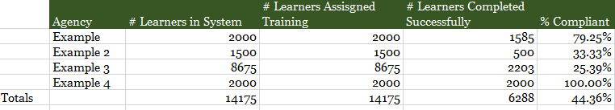
Reporting
Reporting for Georgia
Training Assigned – by Agency & as a whole
Training Taken - by Agency & as a whole
Pass/Fail report - by Agency & as a whole

Slide 8
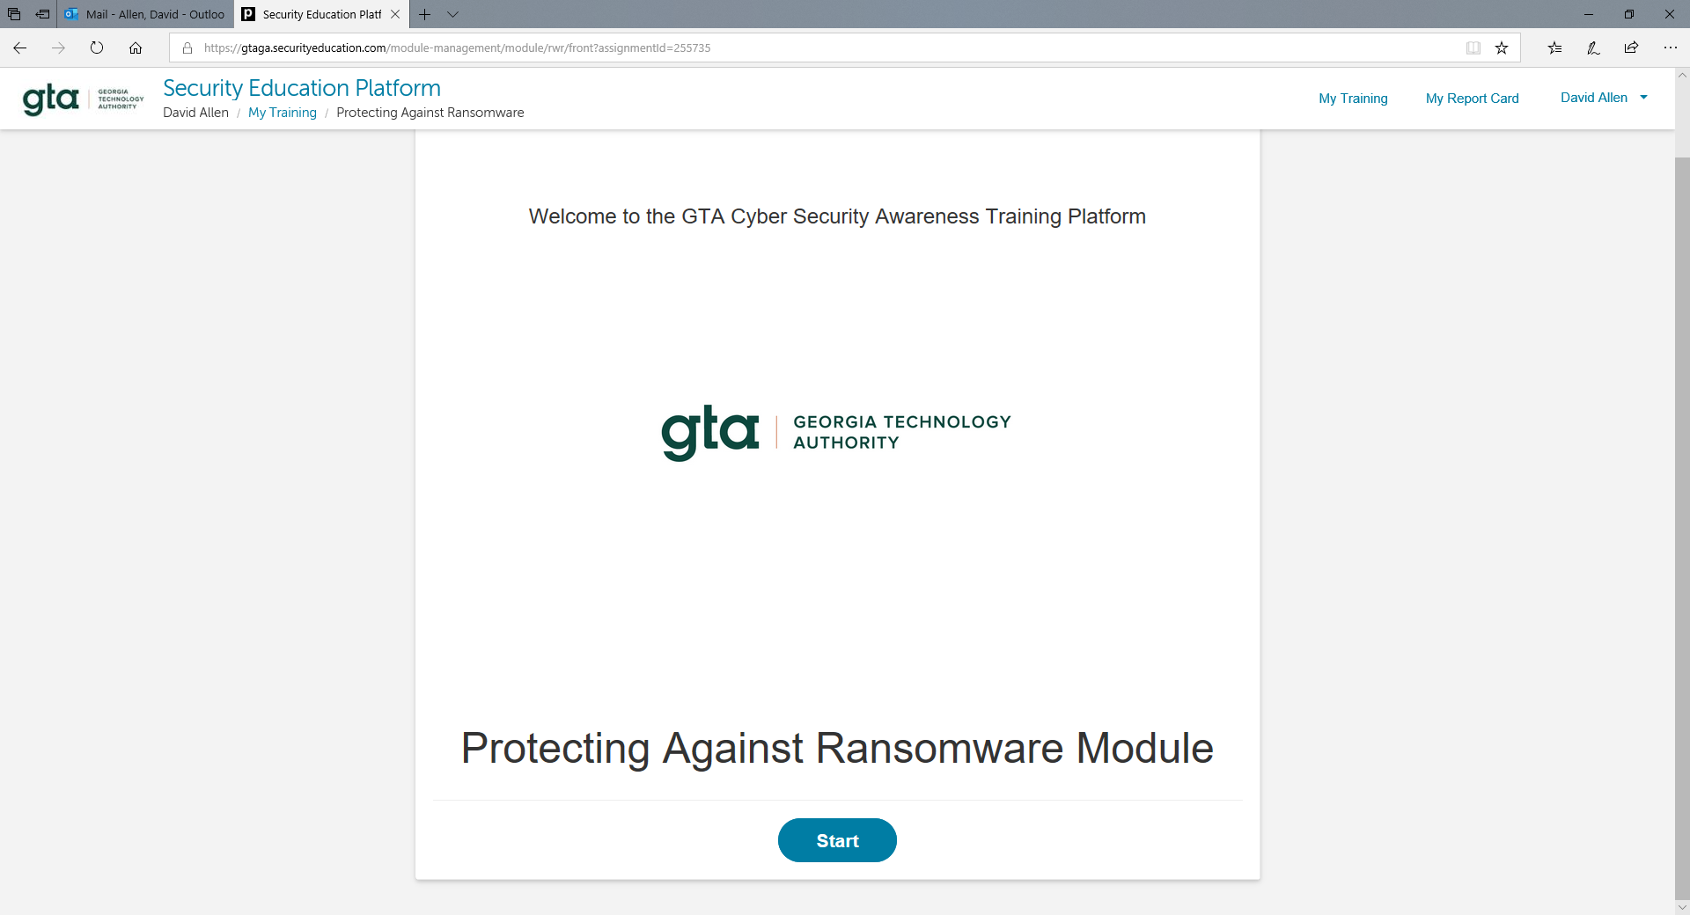

Slide 9
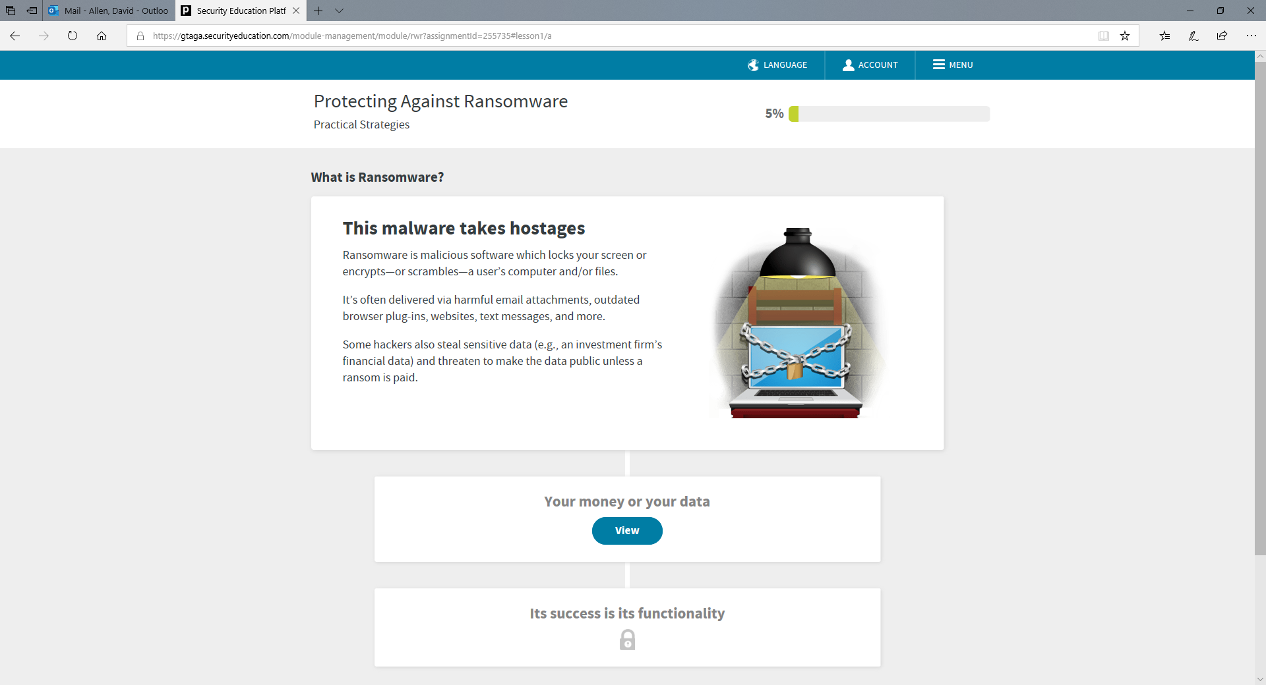

Slide 10
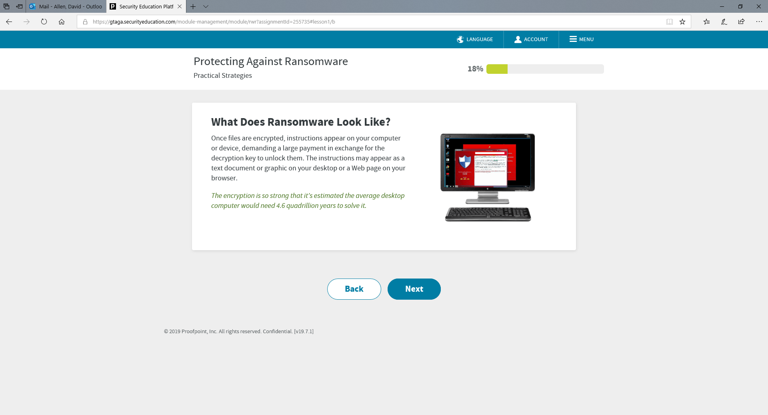

Slide 11
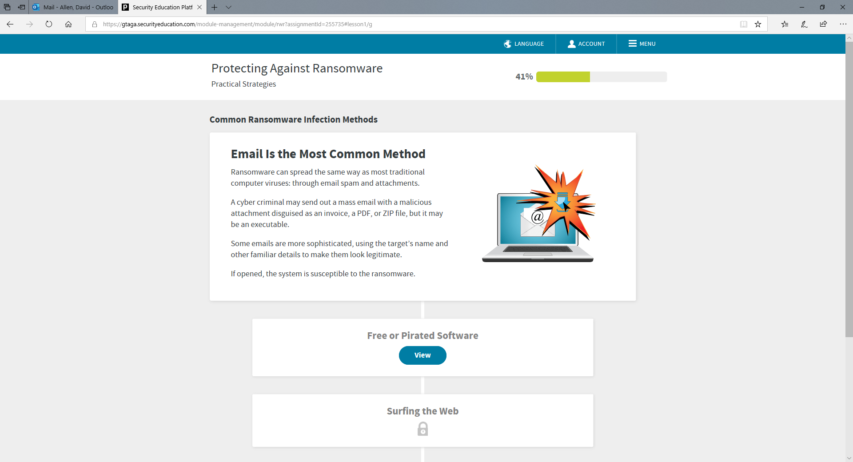

Slide 12
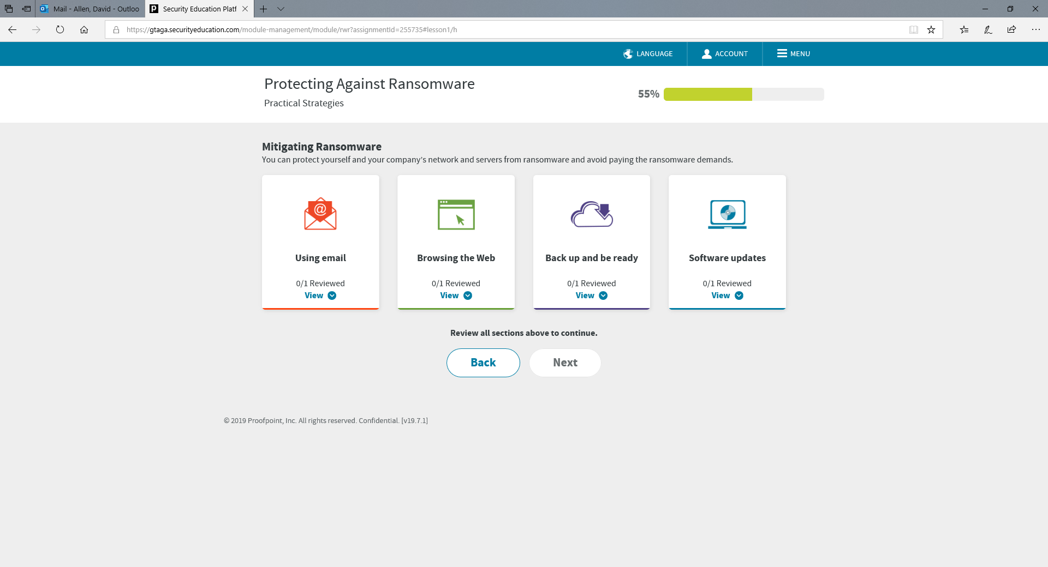

Slide 13
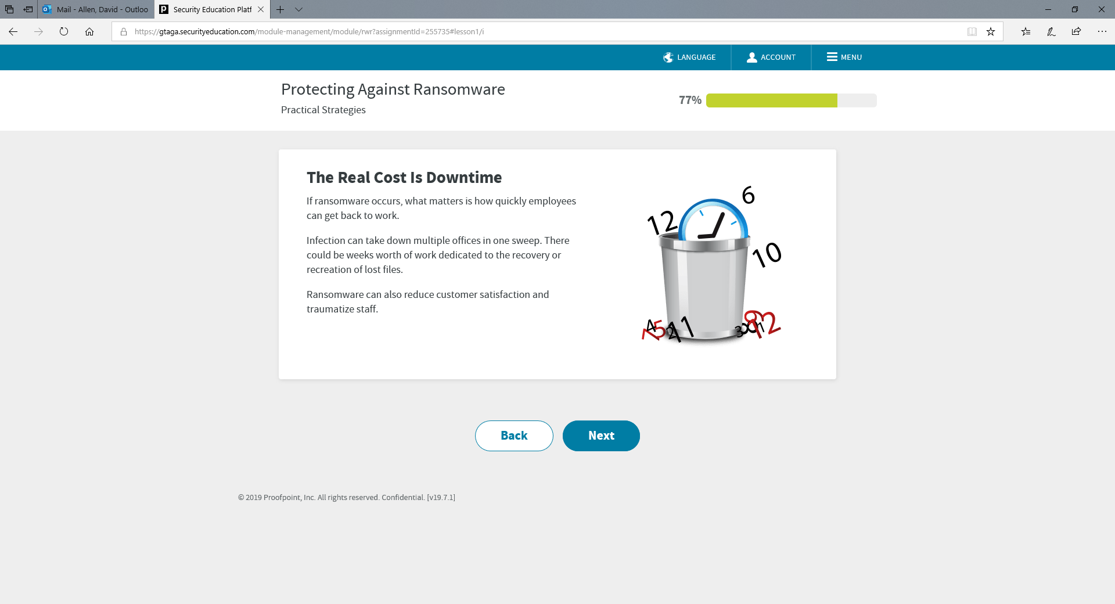

Slide 14
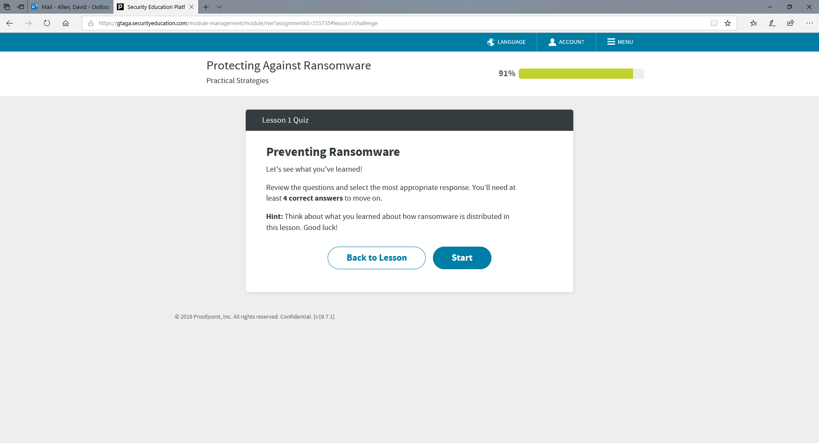

Slide 15
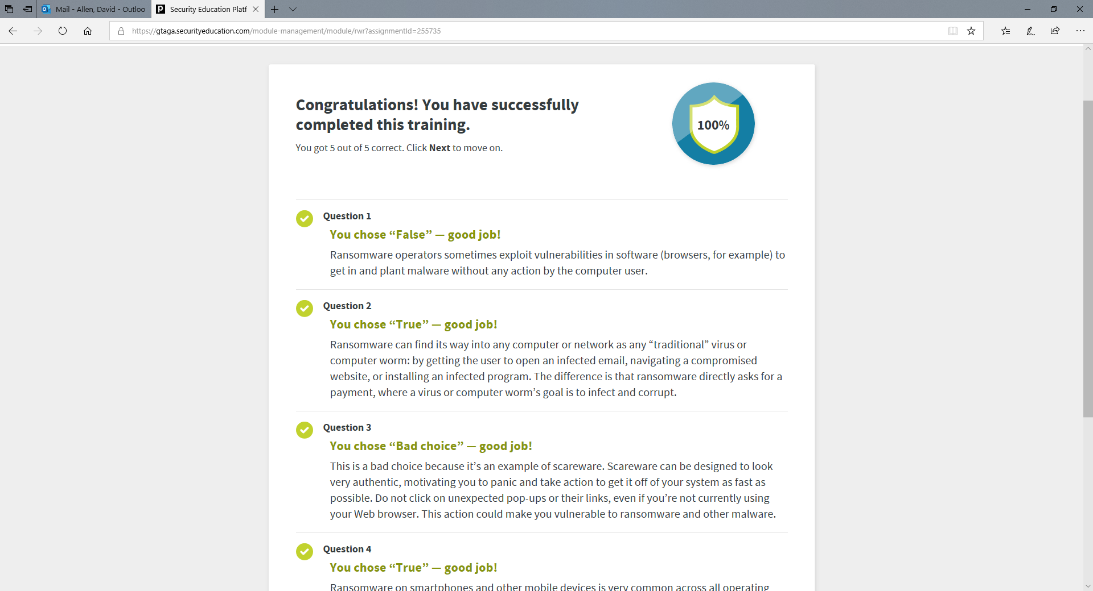

Slide 16
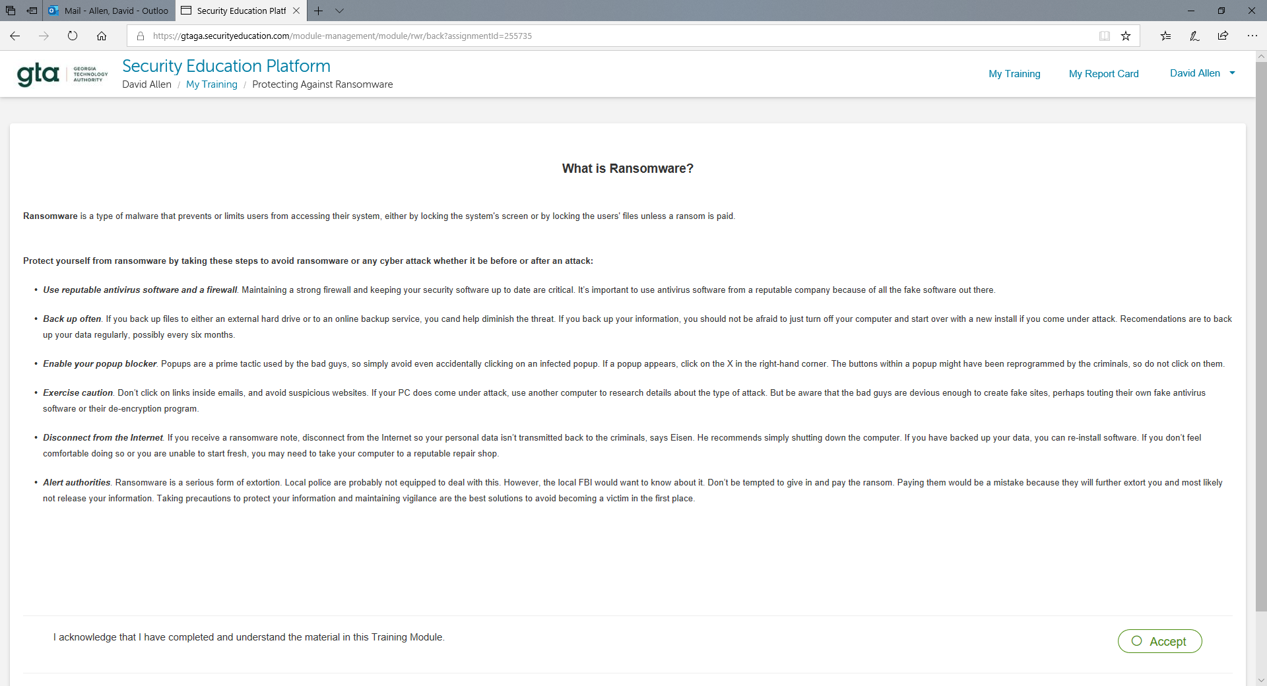

Slide 17
Mandatory Cyber Training Rollout
13 November 2019 – All executive branch employees complete at least one form of cybersecurity training.
13 October 2019 – NLT date for Proof Point modules (Phishing and Ransomware) to be available to executive agencies.
13 September 2019 – Atos begins loading user and module data into Proof Point system.
22 August – 12 September 2019 – Notification to agencies and data collection (employee names and e-mail addresses)

Slide 18
Contacts
OIS Team:
David Allen – CISO
470-270-3218 David.allen@gta.ga.gov
Katina Hopper – Cyber Analyst / Critical Infrastructure
Anna Abbott – Cyber Analyst / Threat Intelligence

Slide 19
Questions

Slide 20
Human Trafficking Prevention Training
Al Howell

Slide 21
Human Trafficking Prevention Training
First Lady spoke at May HR Community Meeting
Video from First Family of Georgia introduces training currently being developed
Full training video will debut at Grace Commission on August 29
First Lady will narrate the training video
Training will be made available to agencies in September 17
Encouraged but not mandatory
Will track number of employees trained
Same delivery method as preventing sexual harassment training

Slide 22
Launching Our 2020 Flexible Benefits Season
Leneequa Morris
Barbara Heard

Slide 23

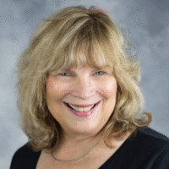
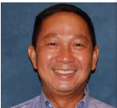
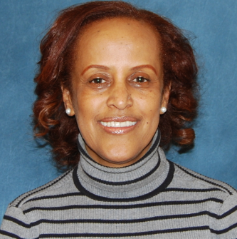

HRA Flexible Benefits Team
Carla Gracen
Director
404-651-5049
Leneequa Morris
Benefits Manager
404-463-7049
Son Truong
Benefits Specialist
404-463-3589
Jody Hiyabu
Benefits Specialist
404-463-1149
Barbara Heard
Benefits Analyst
404-463-2143

Slide 24
Open Enrollment Metrics for Plan Year 2019
141,241 eligible participants (i.e. Actives, Retirees, Unpaid LOA, COBRA)
128,036 participants enrolled in at least 1 Plan Option

Slide 25

2019 Open Enrollment for 2020 Plan Year
October 21, 2019 at 12:00 a.m. ET and ends November 8, 2019 at 11:59 p.m. ET
During Open Enrollment, eligible active employees may:
Enroll in Flexible Benefits coverage
Change Plan Option and/or Vendor
Enroll eligible dependents
Drop covered dependents
Decrease or increase coverage tier
Discontinue Flexible Benefits plan option(s)

Slide 26










2020 Flexible Benefits Vendors
Long Term Disability
Alight
Short Term Disability

Slide 27
2020 Flexible Benefits Program Enhancements and Changes
Name change – Annual Enrollment to Open Enrollment
The 2020 Health Care Flexible Spending Account (FSA) will increase to $2,652
No Changes to the Flexible Benefits Program plan designs
CIGNA DHMO network will expand in the Metro-Atlanta area
MetLife One-UP Campaign is back!
Spouse age will be used to calculate Spouse Life premiums

Slide 28
2020 Flexible Benefits Program Enhancements and Changes, cont’d
Delta Dental Select | 2019 Rates | 2020 Rates
Employee Only | $25.50 | $27.03
Employee + Spouse | $50.33 | $53.34
Employee + Child(ren) | $52.79 | $55.95
Employee + Family | $74.25 | $78.70
Delta Dental Select Plus | 2019 Rates | 2020 Rates
Employee Only | $41.31 | $43.78
Employee + Spouse | $81.52 | $86.40
Employee + Child(ren) | $85.54 | $90.66
Employee + Family | $120.31 | $127.52
5.99% Increase for the 2020 Plan Year
The administrative fee of $0.70 is not reflected in the premium

Slide 29
2020 Flexible Benefits Program Enhancements and Changes, cont’d
Anthem BCBS Vision Select | 2019 Rates | 2020 Rates
Employee Only | $4.80 | $4.91
Employee + Spouse | $10.99 | $11.24
Employee + Child(ren) | $11.53 | $11.80
Employee + Family | $15.84 | $16.20
Anthem BCBS Vision Select Plus | 2019 Rates | 2020 Rates
Employee Only | $8.79 | $8.99
Employee + Spouse | $20.13 | $20.59
Employee + Child(ren) | $20.09 | $21.58
Employee + Family | $29.00 | $29.67
2.3% Increase for the 2020 Plan Year
The administrative fee of $0.70 is not reflected in the premium

Slide 30
Optional Life & AD&D Plan Information for 2020

Slide 31
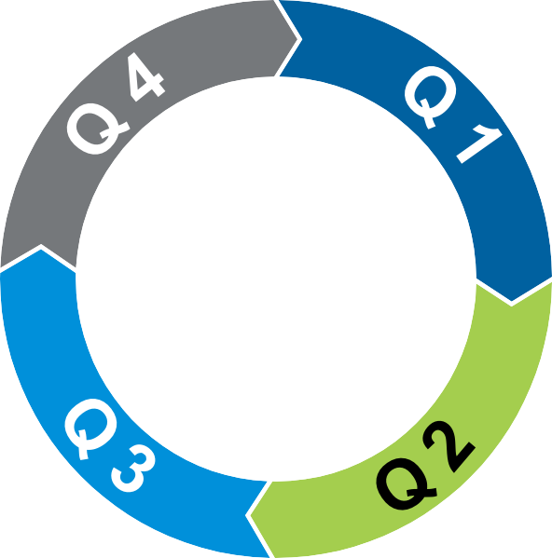
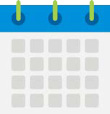

Upcoming Plan Changes for 2020
Rate Calculation of Spouse Life
For the 2020 plan year and beyond, spouse life will be calculated using the spouse’s DOB.
One-Up Campaign
The One-Up campaign allows actively at work employees the ability to go up one level in coverage is guarantee issue and will not require medical underwriting – Statement of Health (SOH).
New hires will have the ability to take advantage of this as well in addition to what is available to them as a new hire.
Current Participants
Any election over 1x requires the completion of a full SOH .
New Participants
Any election over 1x requires completion of a full SOH (late entrants).
AD&D
No changes for 2020.

Slide 32



One-Up Campaign Overview
One-Up is an innovative, turn-key program that gives employees a special opportunity to enroll in supplemental life insurance.
The State has a dedicated MetLife team working on your behalf to deliver a highly targeted, customized enrollment campaign, which includes a personalizes announcement letter and customized plan overview.
The program includes engaging educational materials, online support tools and a simple enrollment process to help optimize your program and drive employee participation.
One-Up helps employers increase the visibility and
the value of your life insurance program through targeted employee communications.

Slide 33
Life Claims Overview

Slide 34


MetLife Group Benefits for State of Georgia Employees
METLIFE GROUP LIFE BENEFITS
ELIGIBILITY
STATEMENT OF HEALTH
LOSS NOTIFICATION
Provides State of Georgia employees with optional insurance:
  Life
  Dependent Life (spouse/child)
  Accidental Death & Dismemberment
Employees can choose some level of insurance coverage without providing medical underwriting (Statement of Health).
Employees have added beneﬁts which include:
  Premium Waiver
  Accelerated Beneﬁts Option
  Portability/Conversion options
  Will preparation services
  Estate resolution services
  Funeral Discounts
Eligible employees may elect up to a maximum beneﬁt of $2,000,000 for Life insurance and up to 10x the employee’s pay for AD&D beneﬁts. Active eligible employees may elect to increase their coverage amounts, which are subject to medical underwriting.
For employees age 65 or older, the amount of life coverage is reduced. The reduction schedule is located in the State of Georgia Group Life Certiﬁcate.
At employee’s option, they have the ability to choose insurance for their spouse and for their child(ren). Note that child life coverage begins at live birth.
After employees select coverage requiring completion of a Statement of Health (SOH) questionnaire they are directed to complete SOH via the GaBreeze Beneﬁts Center.
In the event of an employee and/or dependent loss, notify GaBreeze.
Communicate the loss to GaBreeze and the pertinent information, including, but not limited to:
  Employee/Dependent Name
  Social Security Number
  Date of Birth
  Date of Hire
  Last Day Worked
  Employee status
  Beneﬁciary Information
On the GaBreeze site, users see a “Your
Action Needed” message linking to questionnaire.
Clicking link, users are directed to MetLife website to complete SOH questionnaire.
If the SOH is for the Spouse Life plan, users are asked to provide information which allows MetLife to send email instructions to spouse for SOH completion.
MetLife will review SOH and communi- cate determination to GaBreeze. Dependent on their determination, coverages and deductions will be updated on the GaBreeze system accordingly.*
Once the hinformation has been collected, a report is generated by GaBreeze and transmitted to MetLife to begin processing the claim.
*Note: Eligible dependent children are not required to complete a medical underwriting questionnaire to be eligible for coverage.
Customer-Focused Solutions | Exceptional Service | Proven Expertise
To initiate a claim call GaBreeze at 1(877) 342-7339.
Have questions or need answers? Call 1(877) 255-5862 and for technical support call 1(877) 9MET-WEB.
ADF# DI963.16

Slide 35


Initiating a Life Claim
Overview of Process to Start a Claim after a Loss Notification
ACTIVE EMPLOYEES
DEPENDENT LOSS (CHILD/SPOUSE)
CLAIM ESTABLISHED
Once notification of a loss of an active employee has been received by the SOG agency, contact GaBreeze via
automation or “smart form”.
For a spousal or child loss, the active employee calls to inform GaBreeze of the dependent loss. (Agency/HR is not responsible for reporting.)
When the required information is communicated by GaBreeze to MetLife a claim is created and a claim number is generated. This process establishes the death claim.
EE’s HR Unit completes a “Personnel Action Request Form.
Upon receipt of notification of the dependent loss, the customer service representative (CSR) updates the account with the death status and
triggers a “Qualified Status Change”
even which terminates coverage, if applicable – triggering a “Death Claims Notice”.
After the claim number is generated a beneficiary packet is immediately mailed to the beneficiary on record with detailed instructions on the steps to take next.
Death status is received from the agency via HR file (if automated or “smart form” via the administrator portal on GaBreeze.
Once the information has been updated in the system, death status loads to TBA (Alight system) and triggers coverage termination and a “Death Claims Notice” (DCN) is triggered.
The beneficiary packet will contain forms, the services available from MetLife including, required forms, contact information and numbers, MetLife Advantages and other pertinent information.
The DCN adds the dependent to the daily Death Claims File transmitted to MetLife.
The DCN adds the employee to the daily DCN which is transmitted to MetLife nightly for processing.
Confirmation of enrollment is sent to MetLife for coverage verification.
If no beneficiary designation has been established, benefit will be paid out in the following succession:
  Spouse; (2) Child(ren);
(3) Parents; (4) Siblings.
Note: To expedite the reporting of a claim, the spouse or next of kin may call GaBreeze directly at 877-342-7339.
Once MetLife has received the information on the Death Claims file and dependent verification, MetLife is responsible for processing the claim.

Slide 36

Phone Numbers to Keep Close
Answers are a phone call away.
Claim Initiation: Call GaBreeze at 1-877-342-7339
Claim Initiation & Claim Status
Claim Status: Call MetLife at 1-800-638-6420
MetLife Transition Solutions: 1-877-275-6387
Funeral Planning Services: 1-866-853-0954 or www.finalwishesplanning.com
Grief Counseling Services: 1-855-609-9989
Beneficiary Assistance
Wills Preparation – Hyatt Legal: 1-800- 821-6400 or www.willscenter.com
Social Security Administration: 1-800-772-1213
Veterans Affairs: 1-800-827-1000
Other Pertinent Numbers

Slide 37
Thank You!

Slide 38

Employee Assistance Program (EAP)
The Department of Administrative Services (DOAS) has contracted with KEPRO to administer the Employee Assistance Program (EAP). KEPRO offers valuable benefits ranging from work life services to financial services, with support 24/7.
56 agencies have signed agreements to participate
The enrollment process is still open for this fiscal year, July 1, 2019 through June 30, 2020.
To enroll in the EAP administered by KEPRO, contact Son Truong at son.truong@doas.ga.gov. Forward all signed Participation Agreements to Susan Baker at smbaker@kepro.com.

Slide 39
Let’s Get Prepared!
Checklist
Review the YOU DECIDE booklet prior to Open Enrollment (OE) for any enhancements and/or changes
Attend a Benefit Fair in your area
If applicable, review and compare your options with your spouse’s employer plan(s)
Confirm your access to the enrollment portal, www.GaBreeze.ga.gov, in advance of the OE start date
Confirm your address is current on GaBreeze
Save the dates, October 21, 2019 through November 8, 2019
Remember, now’s your chance to get the benefits you want – be sure to enroll by November 8, 2019!

Slide 40
Flexible Benefits Trivia
What is the name of the governing body that prescribes the general policies by which the Flexible Benefits Program is administered?
Name the vendor that administers the Long-Term care plan option
If you are enrolled in this Flexible Benefits plan option, you can receive up to $160 per calendar year by completing a covered screening test and submitting your request for reimbursement
There are _________Flexible Benefits Program vendors.
Name three Flexible Benefits plan options that premiums are pre-taxed.
Which Flexible Benefits plan option offers coverage to you, your spouse, your parents and parents-in-laws?
Anthem BCBS Vision Select plan option provides coverage for one pair of frames every calendar year. True or False
What does the acronym ABBR stands for and why is it needed?
Which dental plan option does not have an annual dollar maximums?
Delta Dental plan options have a 6-month waiting period on all services. True or False

Slide 41
Preventing Sexual Harassment Update
Jenna Wiese, Deputy Inspector General
Al Howell

Slide 42
Preventing Sexual Harassment Update
# Complaints Received | 100
# Complaints with Impartiality Concerns | 8
Average # of Complaints per Business Day | 0.83
# of Agency Designees Trained | 469

Slide 43
Helpful Reminders
Don’t submit investigative reports to OIG
We only need the conclusion
If investigators exceed 45 days, include approval in case file
Agencies are required to reimburse impartial investigators for travel
If you’re unsure about whether you need an impartial investigator, please call us

Slide 44

Sexual Harassment for Investigators Training
ONLINE TEST
Webinar
Designated Investigator completes online training
Designated Investigator completes online test
Designated Investigator attends live webinar

Slide 45

Sexual Harassment for Investigators Online Training
Training is available online via LMS
Online training is about 60 minutes
Online training contains 7 Modules:
  Introduction
  Preparing for the Investigation
  Initiating the Investigation
  Conducting Witness Interviews
  Special Considerations for Complainants and Respondents
  Miscellaneous Considerations
  Review Evidence, Findings and Conclusions

Slide 46
Sexual Harassment for Investigators Online Test
Investigators can take the online test from their work locations
Online test contains 15 questions
Online test passing score is 80%

Slide 47


Sexual Harassment for Investigators
Investigators must have completed online training and passed the online test to attend the webinar
Webinar is online and live
Investigators can attend from any location and ask questions during the webinar
Webinar contains practical examples
Webinar is approximately 90 minutes

Slide 48
Preventing Sexual Harassment Update
Al Howell

Slide 49
Preventing Sexual Harassment Training Update
Training Completion Rates
68,943 of 77,745 employees (88.7%)
13,705 of 15,322 managers/supervisors (89%)
Continuing Process
Will use same program and timeframes next year (complete by July 1)
Remember that all new employees must be trained within 30 days, and newly promoted supervisors/managers must be trained within 30 days.
Other Tools
Decision Guide by September 2019
Policy Update by January 2020

Slide 50
Campus Recruiting Update
Monique Jenkins

Slide 51

Campus Recruitment – Fall 2019
September
  24th – All Majors Career Fair – University of Georgia
  25th – All Majors Career Fair – Mercer University
October
  2nd – All Majors Career Fair – Georgia College & State University
  17th – Job and Graduate School Fair – Georgia Gwinnett College

Slide 52
Meeting Wrap-up
Al Howell

Slide 53
2019 HR Community Meeting
Dates and Topics
Tuesday, November 19th
FMLA and ADA

Slide 54
Other Upcoming HR Meetings
Wednesday, September 4th through Friday, September 6th
CSPA Conference in Savannah
Wednesday, September 11th
HR Practices Advisory Committee Meeting
*meetings are held monthly on the second Wednesday of each month thru the end of the year
Wednesday, October 16th
Talent Acquisition Forum (formerly TGC Webinar)
Tuesday, November 12th
Employee Benefit Plan Council/State Personnel Board Meeting

Slide 55
404-463-7054

